Slide 1
Chu, T., Wang, Z., Pe’er, D. et al. Cell type and gene expression deconvolution with BayesPrism enables Bayesian integrative analysis across bulk and single-cell RNA sequencing in oncology. Nature Cancer 3, 505–517 (2022). https://doi.org/10.1038/s43018-022-00356-3
Presentation for Directed Study Course

Slide 2
Purpose
Existing deconvolution methods
Assumptions about the difference in dist. between the reference and bulk
Technical and biological batch variation between bulk and scRNA-seq
Not fully supported prediction of gene expression in a heterogeneous population of tumor cells.
key questions:
How do malignant cells affect the composition of non-malignant cells in the TME*?
Which genes are correlated with these interactions？
BayesPrime:
Assume the proportion of reads from each cell type ∝ expression level of genes in each cell type
Accommodate differences between the single-cell reference and bulk
The uncertainty in each estimate can be marginalized out from the joint posterior.
Dataset:
1,412 bulk RNA-seq and 85 scRNA-seq samples from the TCGA from three tumor types: GBM, HNSCC, and SKCM
pseudo-bulk RNA-seq data & ground truth obtained by orthogonal strategies
TME: Tumor Microenvironment; TCGA: Cancer Genome Atelas;
GBM: glioblastoma; HNSCC: head and neck squamous cell carcinoma; SKCM: skin cutaneous melanoma
Notes:
Existing deconvolution methods
Assumptions about the difference in dist. between the reference and bulk
Technical and biological batch variation between bulk and scRNA-seq
Not fully supported prediction of gene expression in a heterogeneous population of tumor cells.
key questions:
How do malignant cells affect the composition of non-malignant cells in the TME*?
Which genes are correlated with these interactions？
BayesPrime:
Assume the proportion of reads from each cell type is proportion to expression level of genes in each cell type
Accommodate differences between the single-cell reference and bulk
The uncertainty in each estimate can be marginalized out from the joint posterior.
Dataset:
1,412 bulk RNA-seq and 85 scRNA-seq samples from the TCGA from three tumor types: GBM, HNSCC, and SKCM
pseudo-bulk RNA-seq data & ground truth obtained by orthogonal strategies

Slide 3
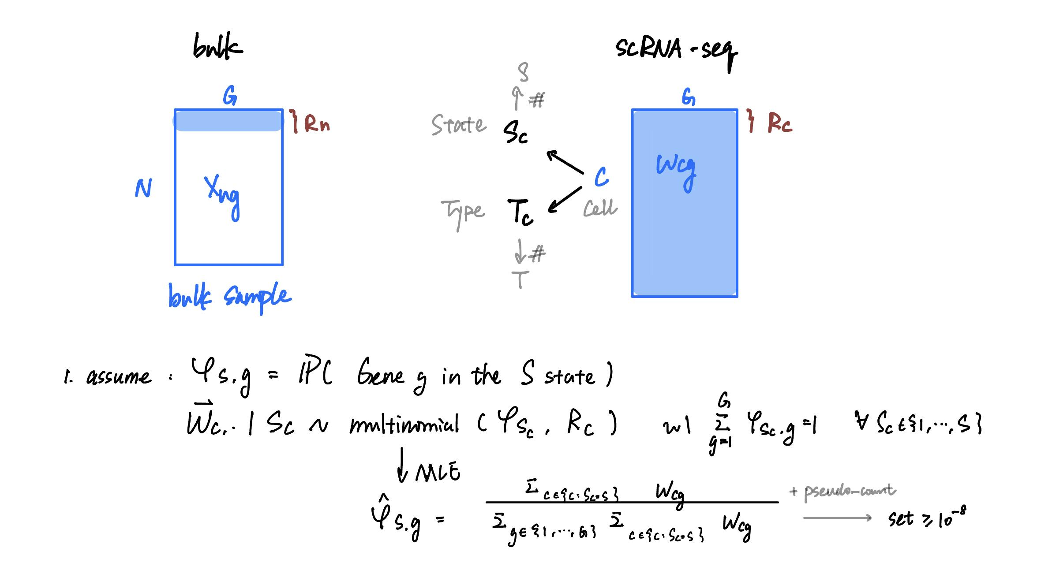
idea

Slide 4
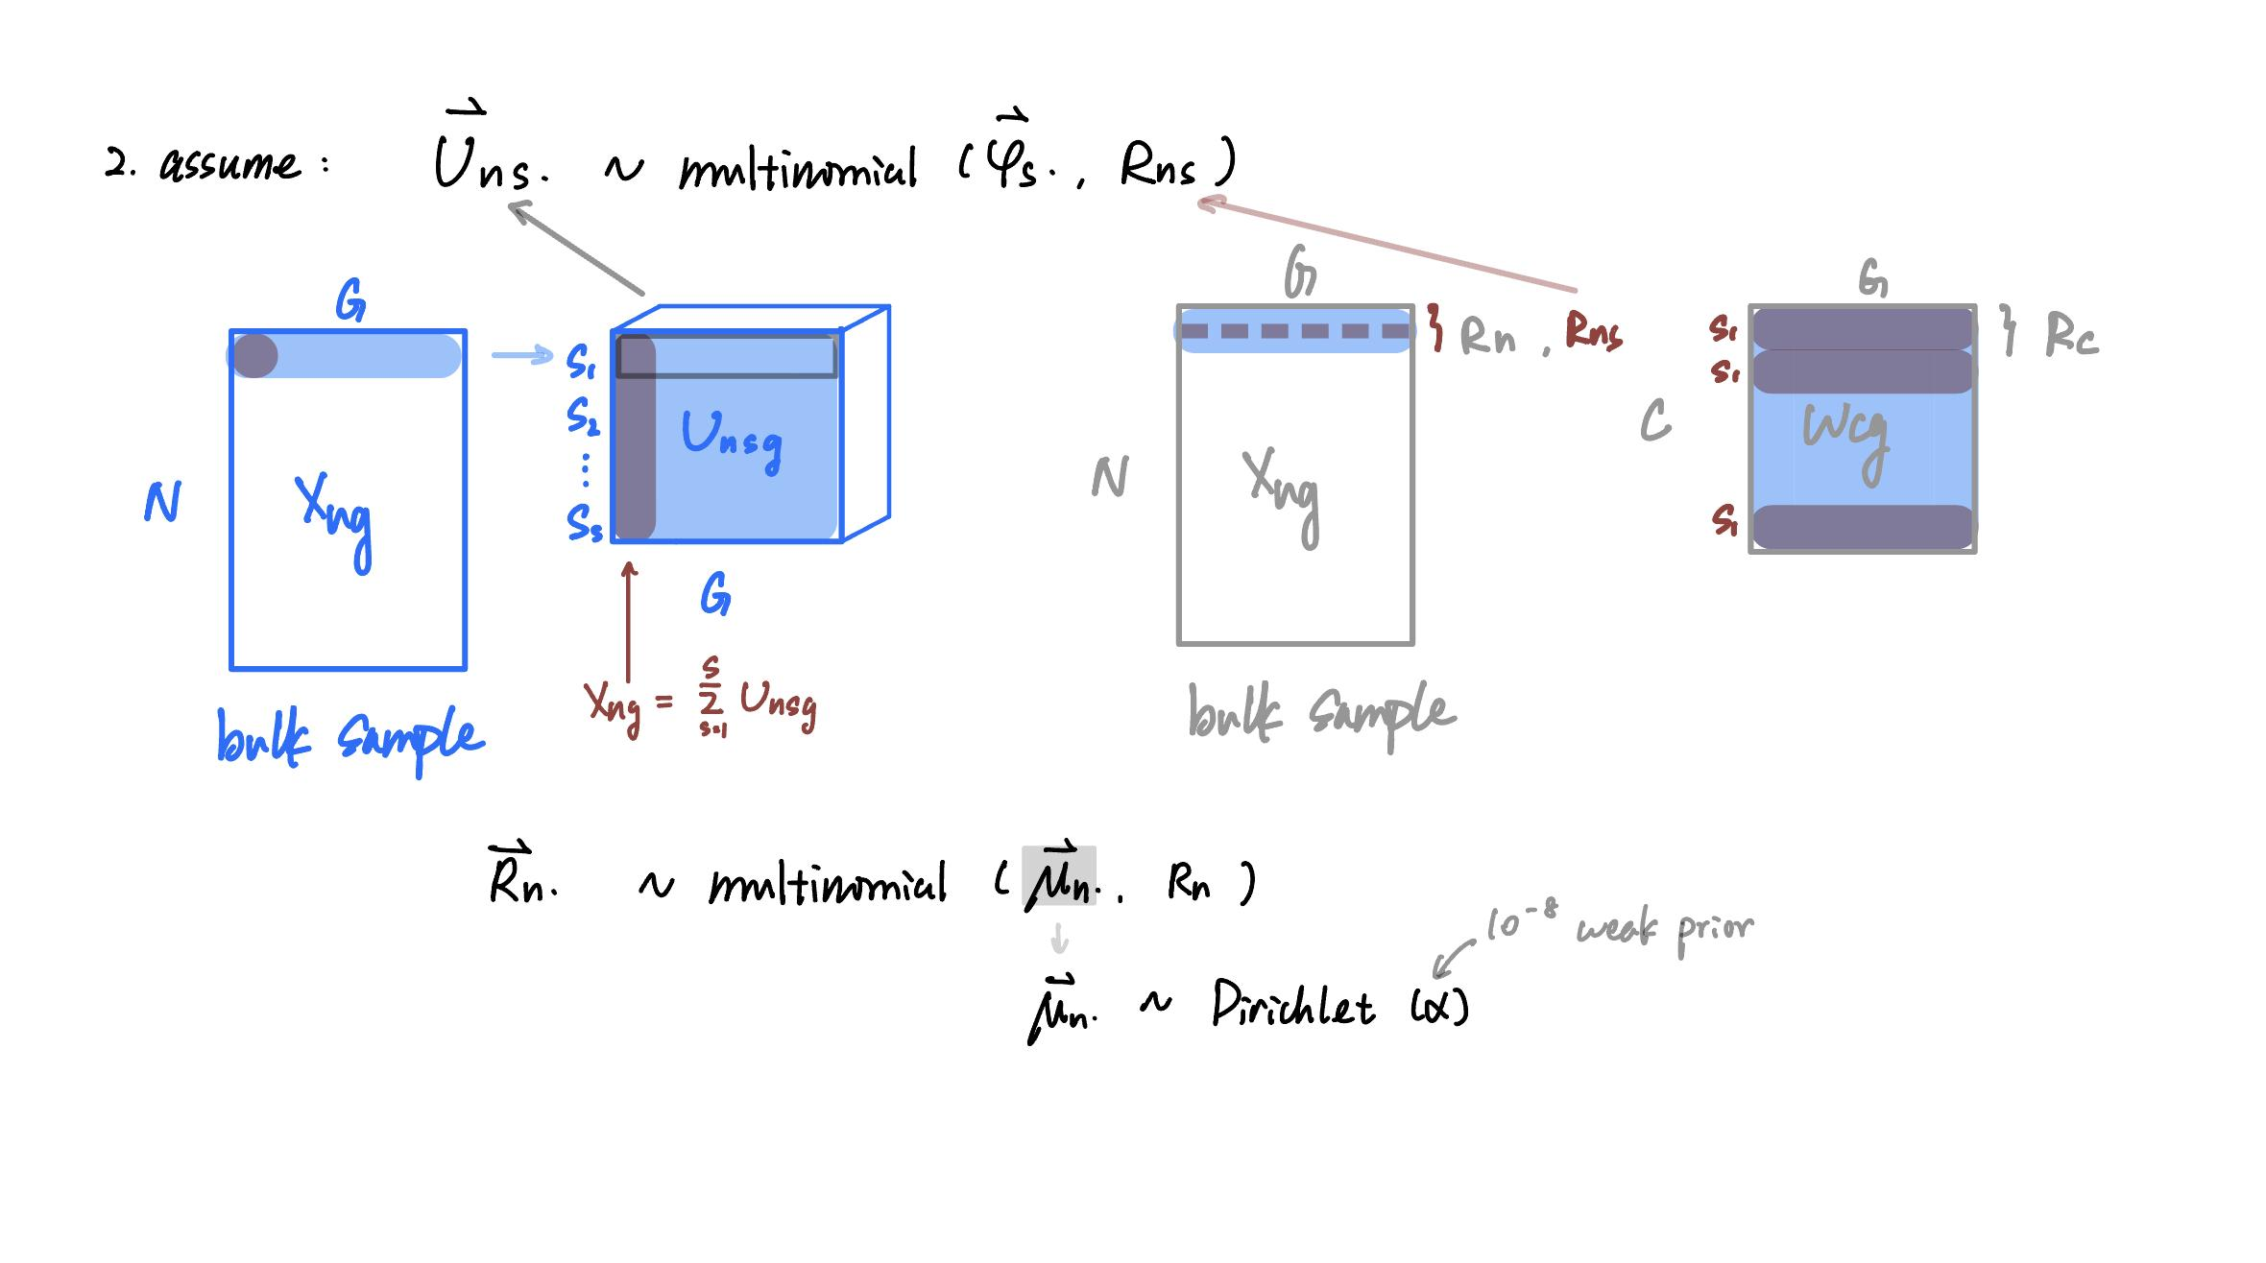

Slide 5
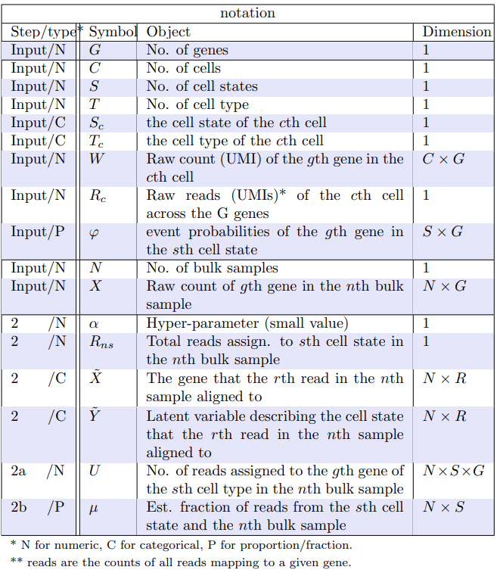
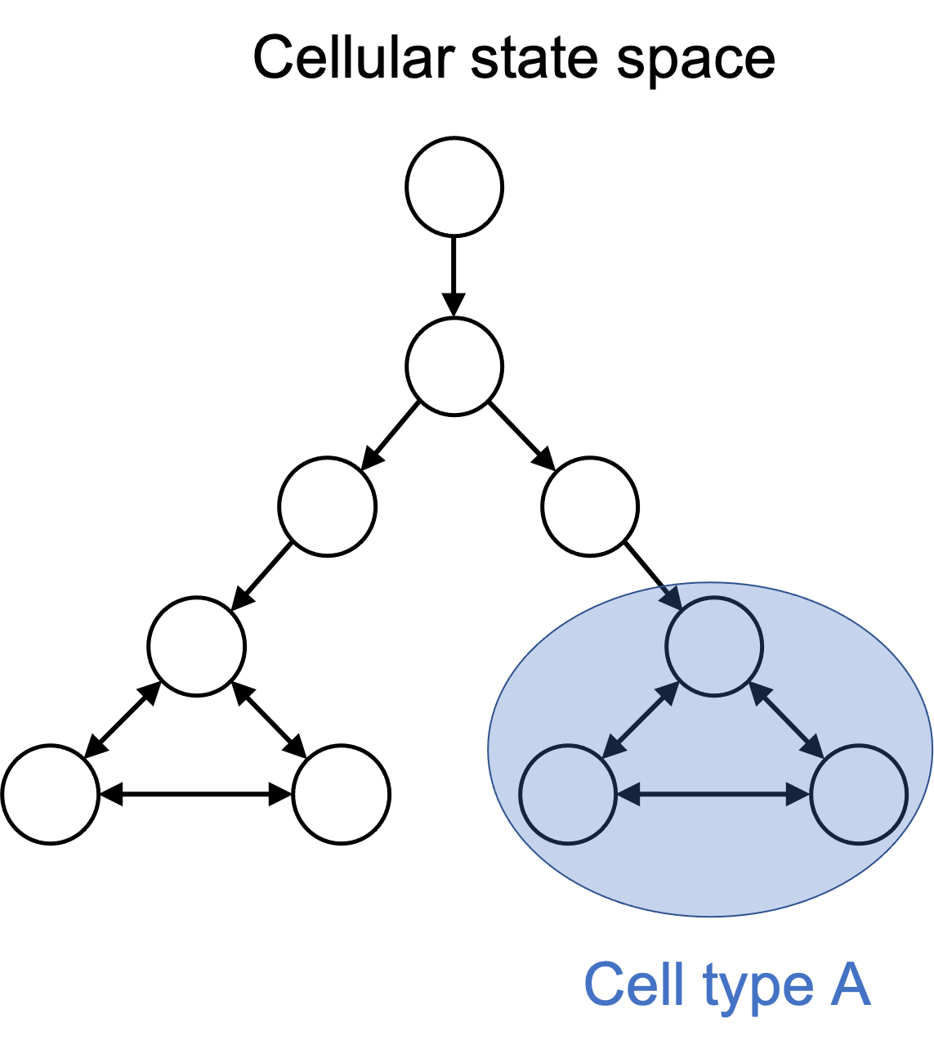
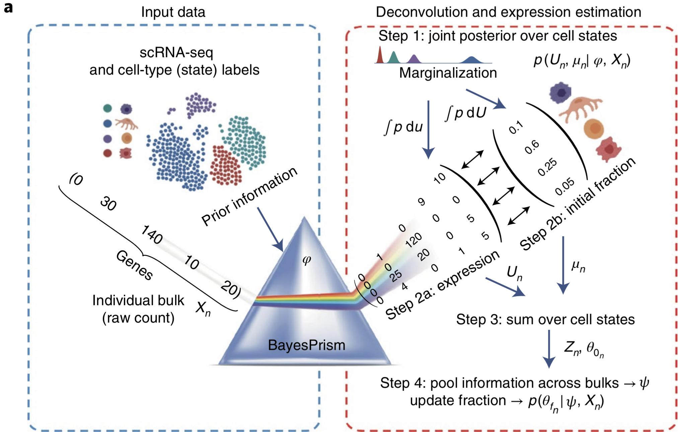
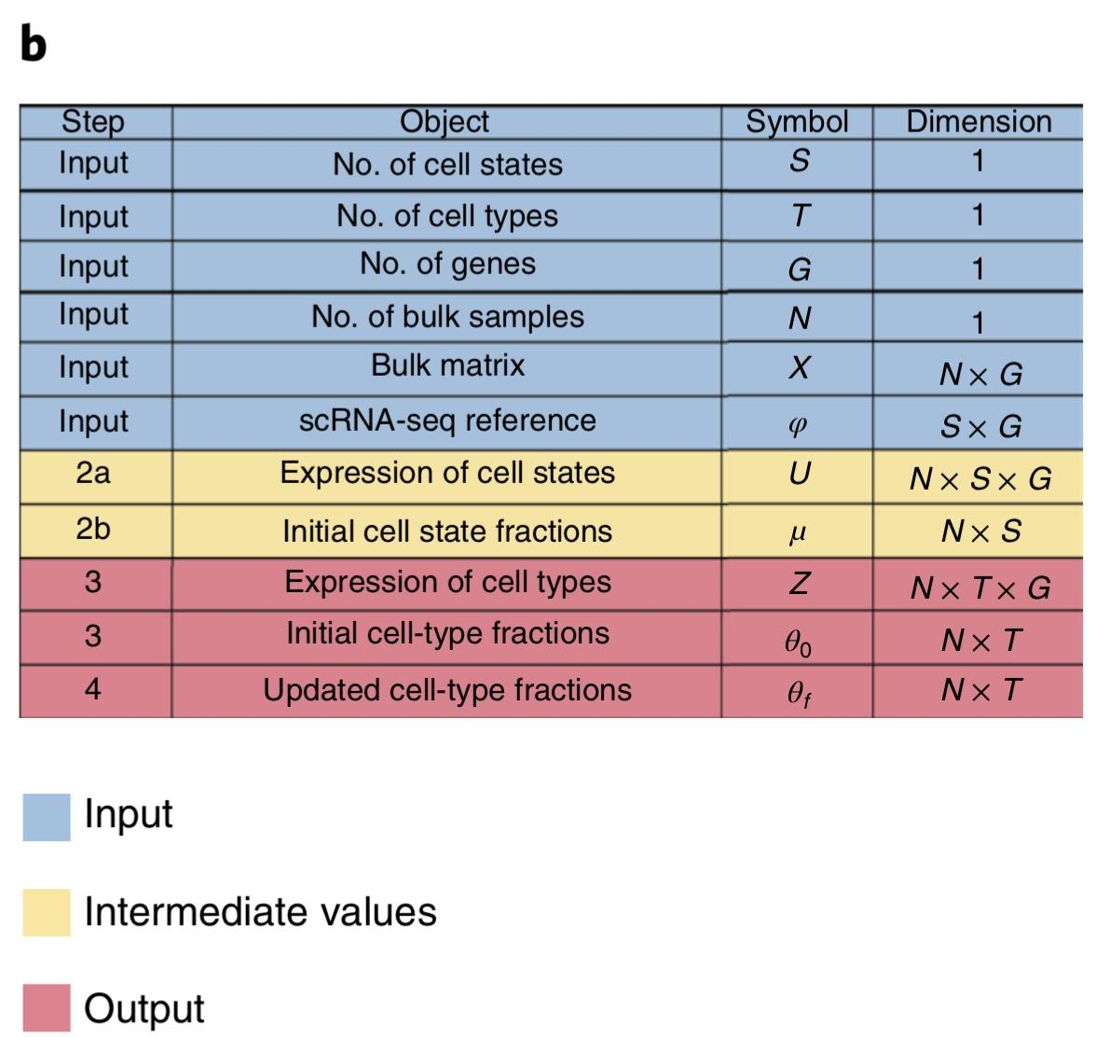
To better accommodate heterogeneity in cell states,
define cell states (or cell subtypes) obtained by further sub-clustering within each heterogeneous cell type.

Slide 6
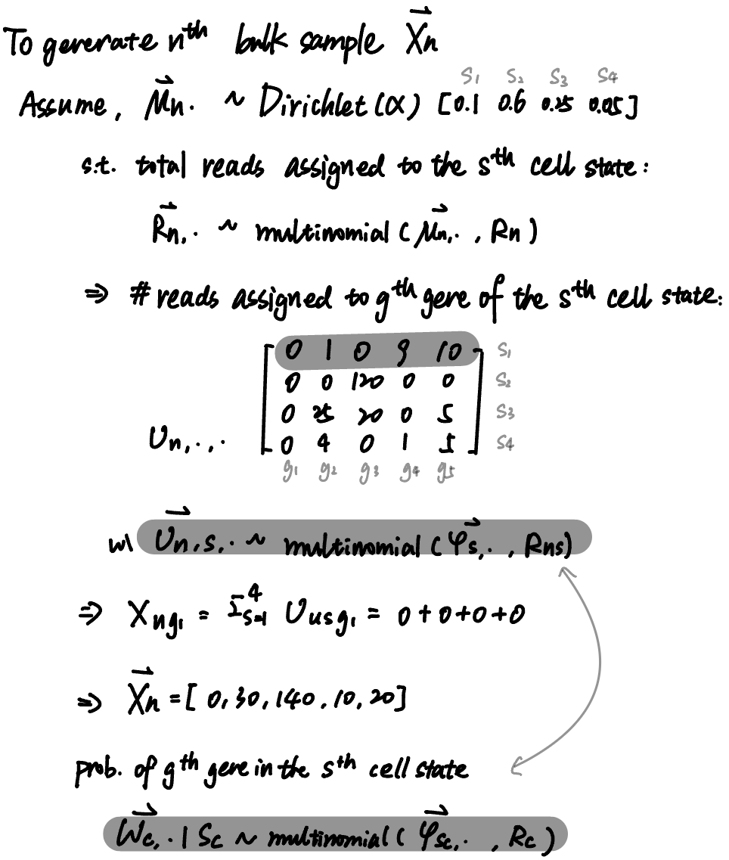
prop. of reads from each s ∝ expression level of genes in each s

Slide 7
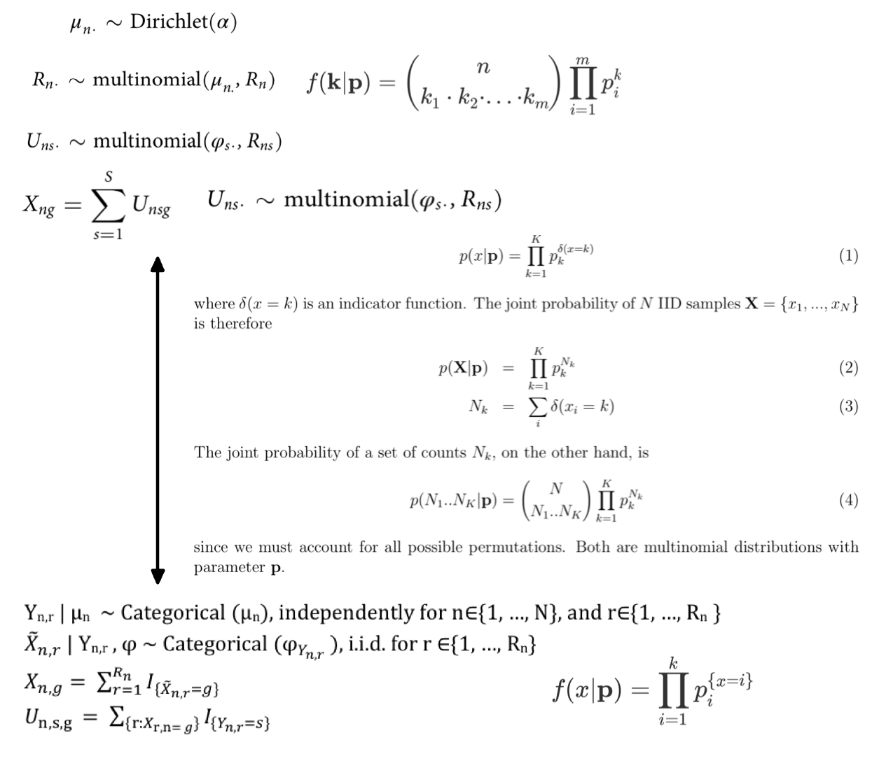

Slide 8
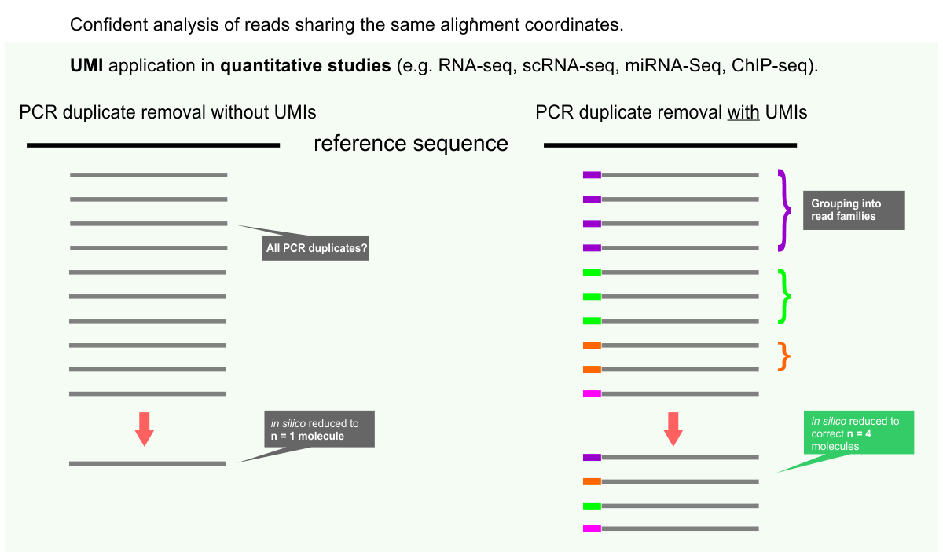

Slide 9
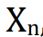
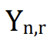
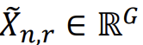
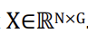
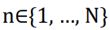
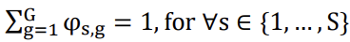
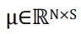
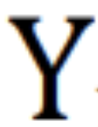

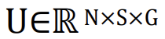
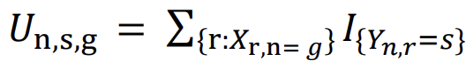
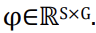
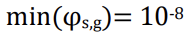
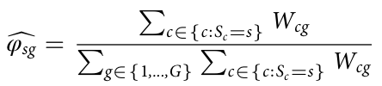
Notation
n measure
r read
g gene
For each bulk sample measured across G annotated genes, reads , and cell states , we have
: raw count of the g^{th} gene in the n^{th} bulk sample, each row X_{n} can be expended to
: the gene that r^{th} read of the n^{th} sample aligned to.
: cell state fraction = # cell state s/ #sample n.
: latent variable of .
: number of reads assigned to the gth gene of sth cell state in the nth bulk sample
: encodes the event probabilities of the g^{th} gene in the s^{th} cell state and ,
event probabilities of the g^{th} gene in the s^{th} cell state
Assume
raw count of the g^{th} genes in the the c^{th} cell
the cell state of the c^{th} cell
total reads of the c^{th} cell across G genes
Notes:
maximum likelihood estimator of multinomial distribution such that and

Slide 10
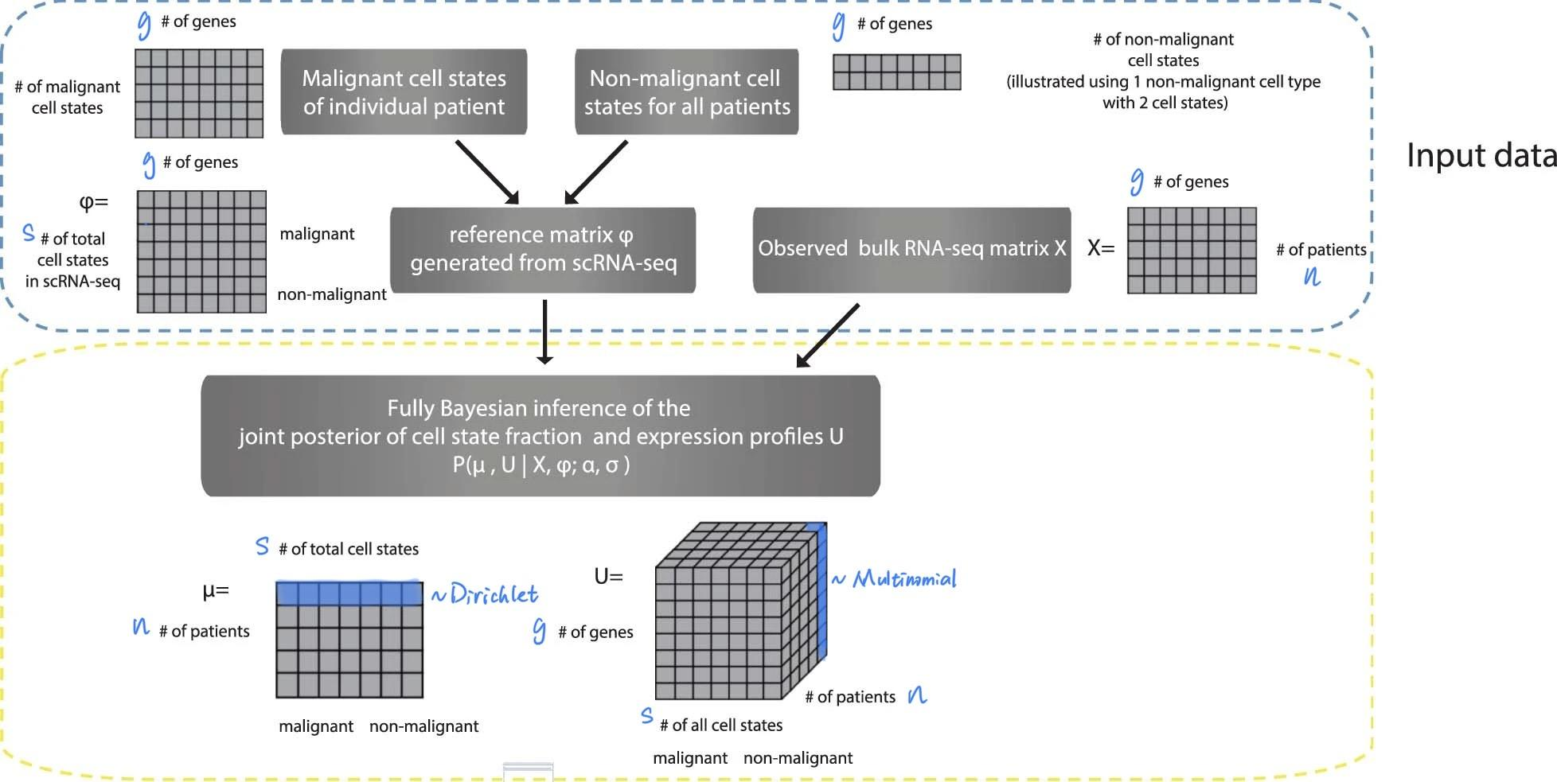
Overview part 1
Step 1
Step 2

Slide 11
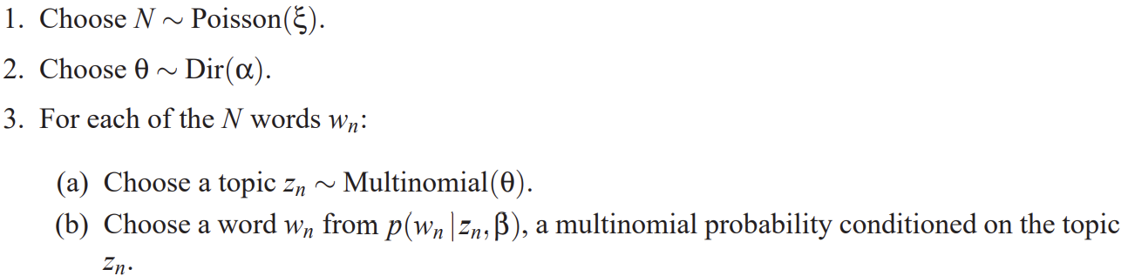
1. Gibbs sampling
Latent Dirichlet Allocation (LDA)
Idea: Assume documents are represented as random mixtures over latent topics, where each topic is characterized by a distribution over words. Generate a probabilistic model of a corpus that not only assigns high probability to members of the corpus, but also assigns high probability to other “similar” documents.
Word ~ each read in bulk seq
Document ~ each bulk seq
Topic ~ gene state
Vocabulary ~ gene
Notes:
David M. Blei, Andrew Y. Ng, and Michael I. Jordan. 2003. Latent dirichlet allocation. J. Mach. Learn. Res. 3, null (3/1/2003), 993–1022.

Slide 12
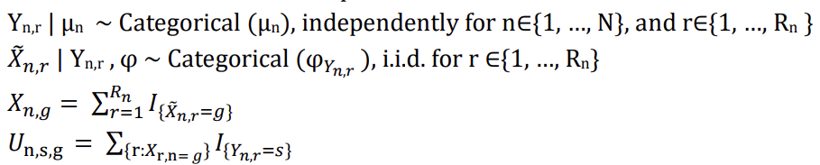
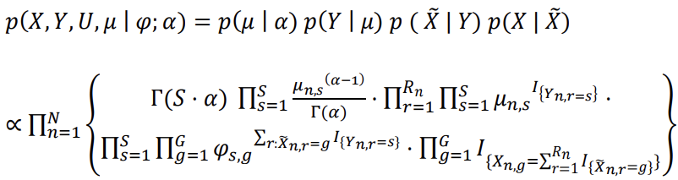
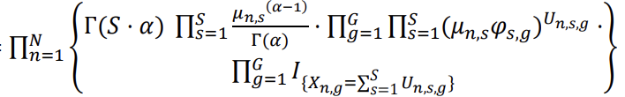
1. Gibbs sampling
Infers a joint posterior distribution p(μ_{n}, U_{n} | φ, X_{n})
Given the assumed prior:
Calculated the joint
density

Slide 13
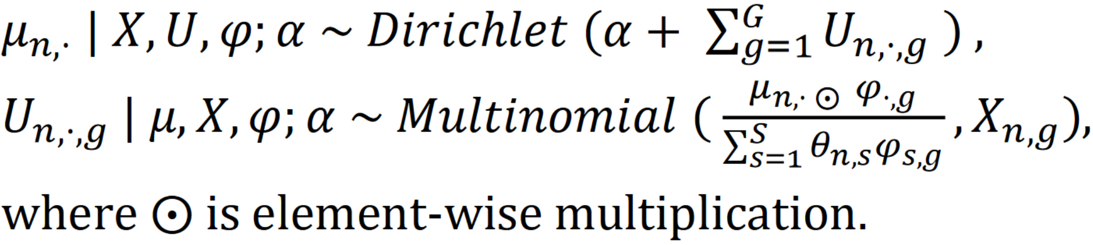
1. Gibbs sampling
Infers a joint posterior distribution p(μ_{n}, U_{n} | φ, X_{n})
Given the assumed prior:
c. Obtain the posterior

Slide 14
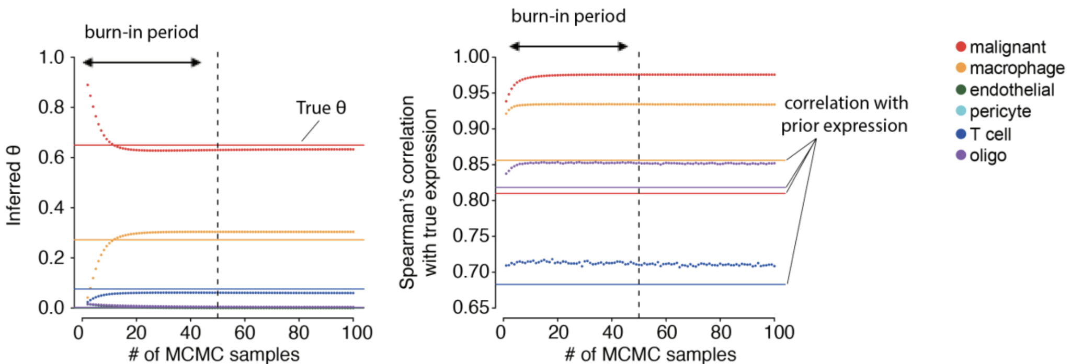
1. Gibbs sampling
Infers a joint posterior distribution p(μ_{n}, U_{n} | φ, X_{n})
Given the assumed prior:
(true cell type fractions)
σ=3, ɑ=10⁻⁸
length of chain = 1000;
burn in = first 500;
thinning =2
scRNA-seq prior

Slide 15
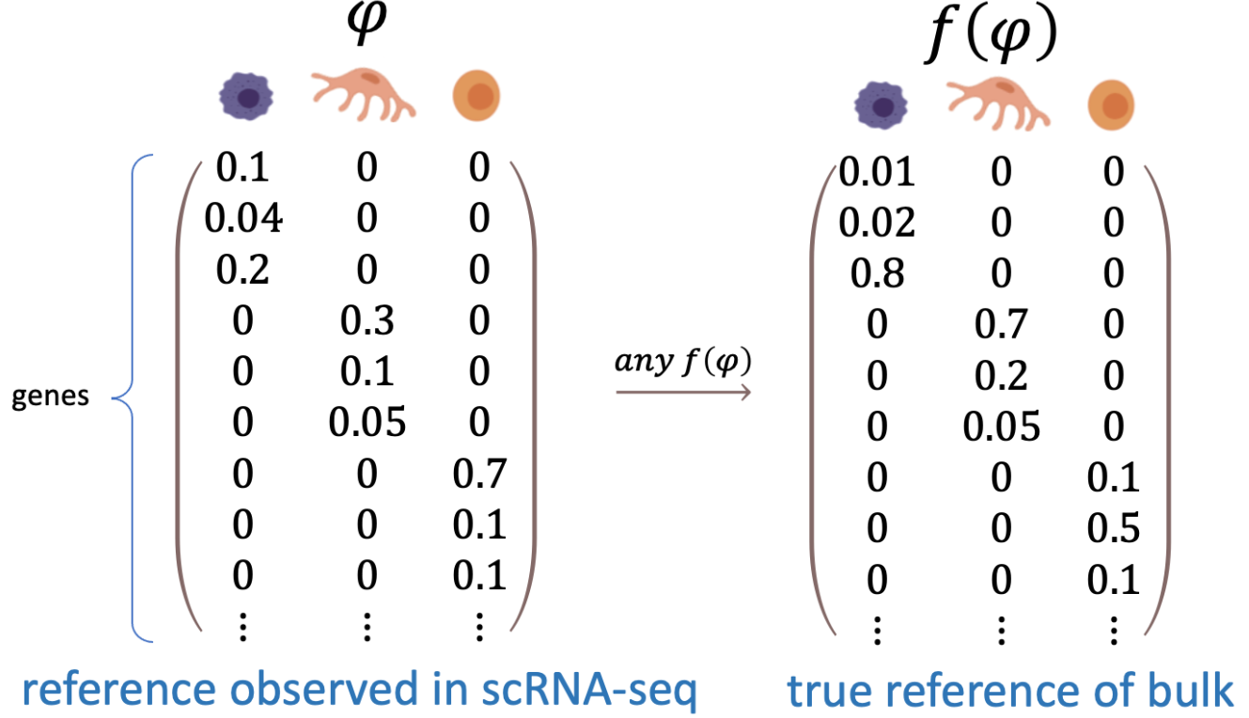
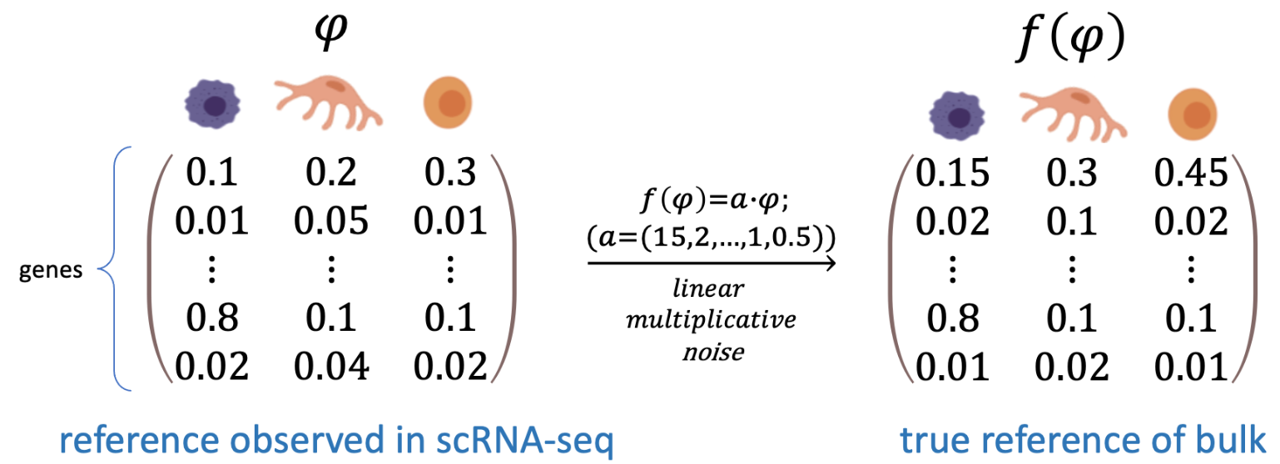
1. 2 Robustness of Gibbs sampling
Recall posterior: BayesPrism is invariant to 2 noises:
a. linear multiplicative noise:
this noise mimics the technical batch effects where genes are captured at different efficiencies by two experimental / sequencing methods
(posterior of U remains the same)
b. any arbitrary transformation noise on marker genes expressed exclusively in one cell type
(U remains the same, for 𝜑_{ij}>0, reads from the marker genes of a particular cell type will be exclusively assigned to that cell type, resulting in a Dirac posterior)

Slide 16
Overview part 1
Step 1
Step 2

Slide 17
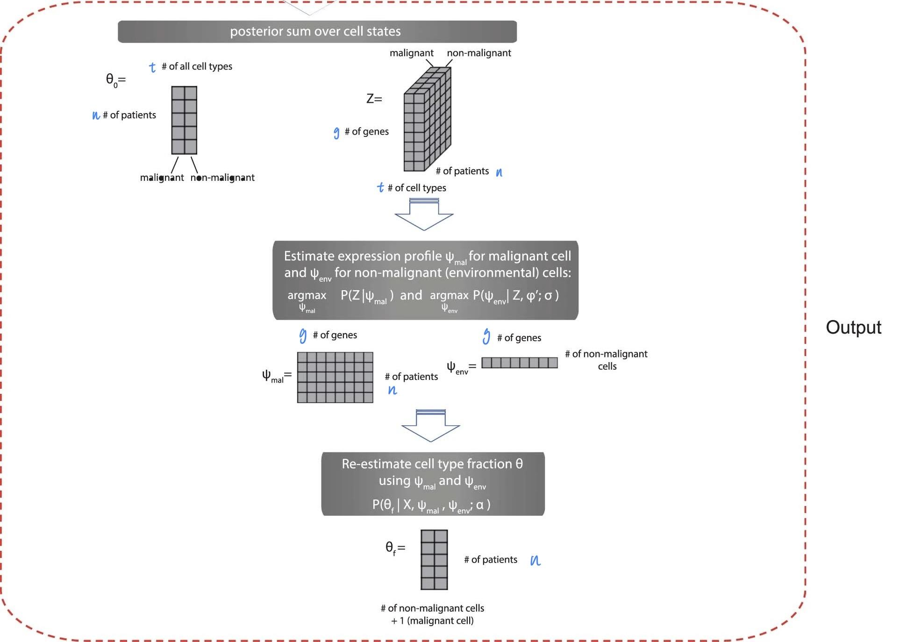
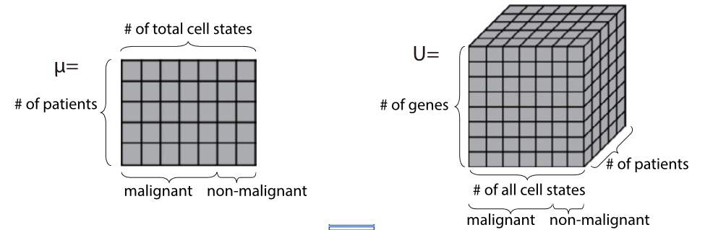
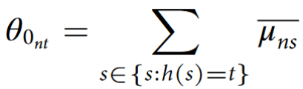
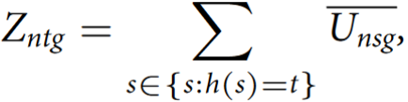
Step 3
h : {1, ..., S}→{1, ..., T}
estimates of fraction of reads for each cell type
gene expression matrix of each cell type -
number of reads assign to g gene of t type in bulk patient n
Step 4
(option)
Overview part 2

Slide 18
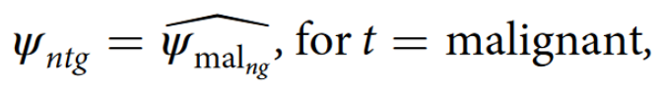
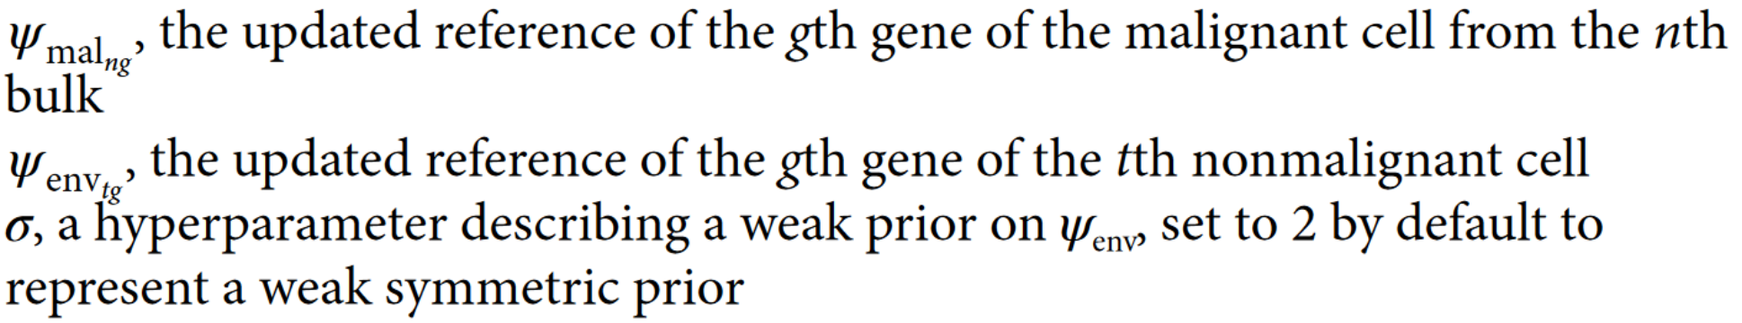
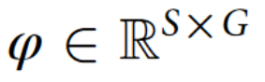
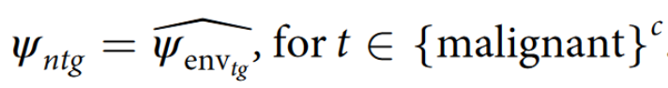
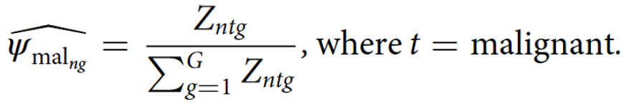
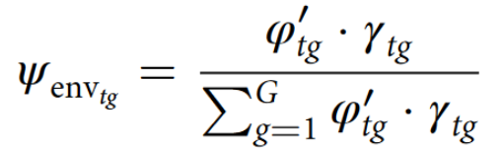
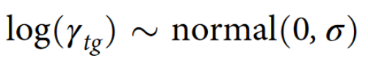
2. Update reference matrix (notation)
Nonmalignant/Malignant cell types are of low/substantial heterogeneity across bulk samples
They are presented at substantial fractions—for example, >1%—in at least one bulk sample
Likelihood function for the expression profiles
Set multinomial distribution with the updated parameter ψ (to replace φ) .
re-estimating the posteriors of cell type fraction using ψ.
Assume:
Hence, the maximum likelihood estimate
total reads assigned to the t^{th} cell type in the n^{th} bulk sample
Notes:
Under situations where (1) nonmalignant cell types are of low heterogeneity across bulk samples and (2) they are presented at substantial fractions—for example, >1%—in at least one bulk sample, it is beneficial to leverage the information shared across bulks to improve the estimates of cell type fractions.

Slide 19
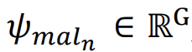
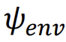
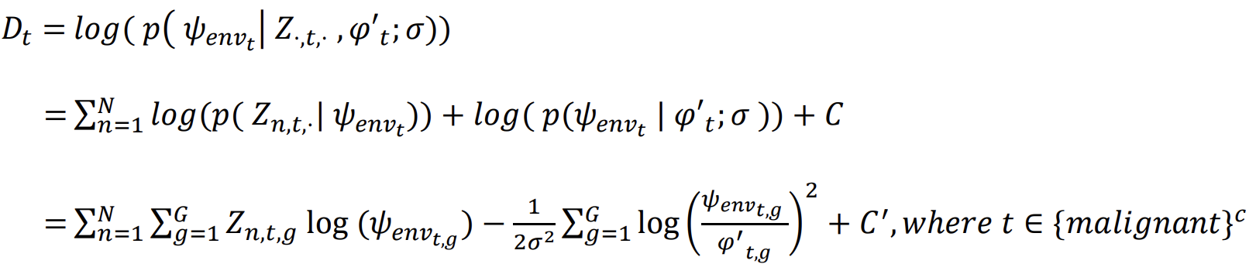
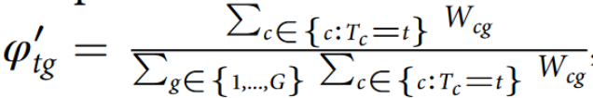
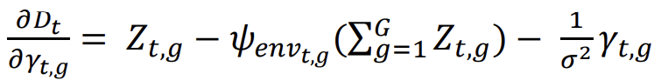
2. Update reference matrix by MLE, MAP
Likelihood function for the expression profiles of malignant cells shared across all patients.
Set multinomial distribution with the updated parameter (to replace φ) .
Likelihood function for the expression profiles of non-malignant cells shared across all patients
use the maximum a posteriori (MAP) estimator for
By change of variables (see Appendix 2), partial derivative of the posterior:
S (solved by conjugate gradient method)
the scRNA-seq reference matrix defined over cell types, similar to φ
Notes:
Under situations where (1) nonmalignant cell types are of low heterogeneity across bulk samples and (2) they are presented at substantial fractions—for example, >1%—in at least one bulk sample, it is beneficial to leverage the information shared across bulks to improve the estimates of cell type fractions.

Slide 20
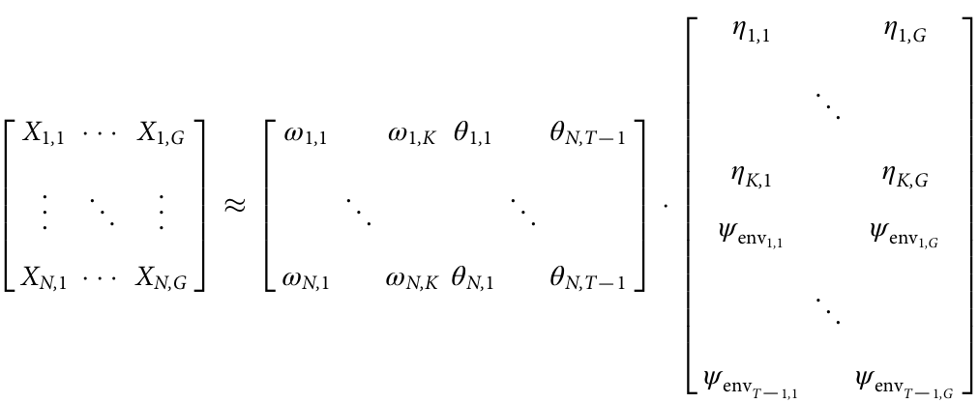
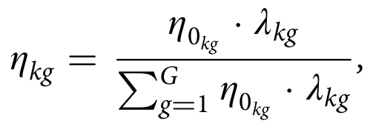
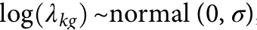



3.1 Latent embedding
identify gene expression patterns that arise commonly among bulk RNA-seq samples after removal of nonmalignant cells infiltrating the tumor
Need to solve non-negative matrix factorization (NMF) problem: X≈ υ · ζ , with υ ∈ R^{N×M} and ζ ∈ R^{M×G}, where M = K + T − 1, ω and η are latent variables inferred
(Malignant bases)
η₀: a prior guess of gene programs of malignant cells.
(Observed)

Slide 21

3.1 Latent embedding (con’t)
identify gene expression patterns that arise commonly among bulk RNA-seq samples after removal of nonmalignant cells
Need to solve non-negative matrix factorization (NMF) problem: X≈ υ · ζ , with υ ∈ R^{N×M} and ζ ∈ R^{M×G}, where M = K + T − 1, K<<N. ω and η are latent variables inferred
(Observed)
Fig 4.a

Slide 22




3.1 Latent embedding
associated weights
a hyperparameter describing a weak prior on ψ_{env}
initial K tumor basis
Fig. SN2. Graphical model illustrates the statistical dependencies and the generative process for the observed bulk RNA-seq data, X. Red text marks hyper-parameters; blue marks observed variables; black marks latent variables.
Notes:
As ω, η, and Z are all latent variables and are marginally dependent on each other, direct inference can be difficult. Considering the advantage of marginalizing nuance variables5, we use the Expectation-maximization (EM) algorithm to optimize η while marginalizing 𝜔 and V.

Slide 23

3.2 Expectation-maximization (EM) algorithm
optimize η while marginalizing 𝜔 and V
Definition:
https://en.wikipedia.org/wiki/Expectation%E2%80%93maximization_algorithm
Notes:
**1. ** Expectation (E-step): In the first step, the algorithm makes an educated guess about the missing or hidden information in the data. It computes the probability of each possible scenario given the observed data. Think of it as estimating what the missing data might look like based on what you already know.
**2. ** Maximization (M-step): In the second step, the algorithm uses the observed data and the educated guesses from the E-step to refine its understanding of the underlying parameters of the model. It adjusts the parameters to maximize the likelihood of the observed data. Essentially, it updates the model based on the new, more complete information obtained from the E-step.
These two steps (Expectation and Maximization) are repeated iteratively. With each iteration, the algorithm refines its estimates of both the missing data and the model parameters. The process continues until the estimates converge to a stable solution, meaning they no longer change significantly between iterations.

Slide 24



3.2 Expectation-maximization (EM) algorithm
optimize η while marginalizing 𝜔 and V
Problem: argmax , where Q =
E step:
Posterior Q describing the posterior of V is sampled by Gibbs sampling:
recall
Notes:
**1. ** Expectation (E-step): In the first step, the algorithm makes an educated guess about the missing or hidden information in the data. It computes the probability of each possible scenario given the observed data. Think of it as estimating what the missing data might look like based on what you already know.
**2. ** Maximization (M-step): In the second step, the algorithm uses the observed data and the educated guesses from the E-step to refine its understanding of the underlying parameters of the model. It adjusts the parameters to maximize the likelihood of the observed data. Essentially, it updates the model based on the new, more complete information obtained from the E-step.
These two steps (Expectation and Maximization) are repeated iteratively. With each iteration, the algorithm refines its estimates of both the missing data and the model parameters. The process continues until the estimates converge to a stable solution, meaning they no longer change significantly between iterations.

Slide 25





3.2 Expectation-maximization (EM) algorithm(con’t)
optimize η while marginalizing 𝜔 and V
M step:
recall
where Q =
Notes:
Posterior Q is sampled by E step

Slide 26
Dataset
1142 samples from the TCGA from three tumor types: GBM, HNSCC, SKCM.
estimates of 6 cell types for GBM, 10 for HNSCC and 8 for SKCM
Constructed pseudo-bulk RNA-seq data that differed from the reference scRNA-seq dataset by a log-normally distributed multiplicative noise term
Generation reference expression profile by:
Data normalization (w\ size factors estimated by scran38) and transformation
Dimensionality reduction w\ randomized Singular Value Decomposition
Clustered the data w\ PhenoGraph40
Defined malignant cell states:
Subclusters of malignant cells generated in each individual patient (refVFM8: 60 subclusters for 8 patients in original paper)
By patient ID (scHNSCC and scSKCM)
Aggregated read counts in each cell state to generate the reference profile φ across all patients
Performed the inference on protein-coding genes when deconvolving TCGA data to speed up downstream analysis
Remove sex-specific transcription states, and ribosomal protein-coding and mitochondrial genes, outlier genes to reduce batch effects.

Slide 27

Dataset
1142 samples from the TCGA from three tumor types: GBM, HNSCC, SKCM.
estimates of 6 cell types for GBM, 10 for HNSCC and 8 for SKCM
Constructed pseudo-bulk RNA-seq data that differed from the reference scRNA-seq dataset by a log-normally distributed multiplicative noise term
Fig. 2 a Violin plots for dist. of cell type fraction in each tumor type
Compared between the ground truth and cell type proportions estimated using five different deconvolution methods
Pearson correlation ( z-test was performed on Fisher’s z-transformed cell-type-level correlation coefficients)
MSE (T-test)

Slide 28
Deconvolution
Generation reference expression profile from scRNA-seq (each tumor type)
summed raw read counts
re-clustered cell types based on the original scRNA-seq studies
normalized the raw reads then transformed
removed ribosomal protein-coding genes and genes from chrM, chrX and chrY
performed dimensionality reduction using the rSVD
clustered the data on the reduced dimension using PhenoGraph with default parameters 40
subclusters of malignant cells generated by PhenoGraph40 in each individual patient
defined malignant cell states using patient ID
aggregated read counts in each cell state to generate the reference profile φ across all patients
performed the inference on protein-coding genes when deconvolving TCGA data to speed up downstream analysis
Remove sex-specific transcription states, and ribosomal protein-coding and mitochondrial genes, outlier genes to reduce batch effects.

Slide 29


Datase
To filter out false correlations and enrich for intrinsic gene expressed by malignant cell in gene enrichment analysis
distribution of mean of z scores of expression over a set of correlative genes (with Spearman’s corr> 0.25) from the corresponding scRNA-seq dataset of the corresponding tumor types
Fig. 2 a
correlative genes showed higher expression in tumor cells

Slide 30
Dataset
Malignant intrinsic filter:
Normalize raw count
-> log transform
-> maximum p value (t-test) between each malignant cell state and every other non-malignant cell state/ type < 0.01
Regress-out filter:
θ_{t} ~ β_{0(t,g)}·log₂(Y_{(mal,g)}) + β_{1(t,g)}·log₂(Y_{(t,g)})
θ_{t} is the proportion of query cell type t.
Y_{n(mal,g)} is z_{n(mal,g)} normalized by the norm.to.one function, similar to Y_{(t,g)}.
When the query cell type is presented with non-zero fractions, we can directly apply the norm.to.one function on Z_{n(t,g)} to obtain Y_{n(t,g)}.
Fig. 2 a

Slide 31

BayesPrism improved deconvolution performance
One size p-value
Human PBMC scrNA-seq and mouse brain cortex samples from different healthy subjects and sequenced by different scRNA-seq platform
technical batch effects with small amounts of biological variation
a & b: n=200 pseudo-bulks simulated using 253 single cells collected from one healthy adult and mouse cortex single nucleus-seq
c & d: n=200 pseudo-bulks simulated using 295 single cells collected from one mouse
PBMCs: peripheral blood mononuclear cells
Extended Data Fig. 3

Slide 32

BayesPrism improved deconvolution performance
Leave-one-out tests in datasets of three human cancer types generated by the same sequencing platforms
biological variation with small amounts of technical noise
Est. value from HNSCC and SKCM versus the ground truth in pseudo-bulk
a & b: Scatter plots of θ₀
c & d: of CIBERSORTx inferred cell type fraction
Extended Data Fig. 4a–d

Slide 33

BayesPrism improved deconvolution performance
BayesPrism obtained more accurate estimates of five cell types in the bulk sample than other deconvolution methods (P<5.46×10–4 on MSE, P<0.03 on correlation coefficients)
GBM datasets generated from different cohorts using different sequencing platforms
mixture of both effects
c & d: 1350 / 270 GBM28 pseudo-bulks using refGBM8 from 27 patients with GBM having more than ten malignant cells for all methods / CIBERSORTx
e & f: 12 real bulk RNA-seq human whole blood samples with ground truth measured by flow cytometry
Fig. 1c-f

Slide 34

How the accuracy of gene expression estimates
would be affected by the proportion of malignant cells?
The correlation between BayesPrism gene expres-
sion estimates and known ground truth was >0.95 for tumors, with >50% purity (Fig. 1h)
Fig. 1 h. Scatter plot showing Pearson’s correlation between average expression of malignant cells in pseudo-bulk and that estimated by BayesPrism (red) and CIBERSORTx group mode (orange) or the undeconvolved simulated bulk (blue), as a function of the fraction of malignant cells in a subsampled set (n= 270)

